Slide 1
ENGR 301
Engineering Management Principles and Economics
Lecture 1B
Project Delivery Systems
Work Breakdown Structure
Dr C.J. Willis, CAPM, P.Eng
‹#›

Slide 2
Learning Objectives
After this lecture learners will:
Understand the basis of project delivery systems
Understand the types of project delivery systems that are available
Understand the reasons for planning and the elements of the project master plan
Know what is a work breakdown structure
References:
Project Management in Practice, 2nd Edition. Mantel, S., Meredith, J., Shafer, S. and Margaret, S. John Wiley and Sons Inc. 2005
Dr C.J. Willis, CAPM, P.Eng
‹#›

Slide 3
Project Delivery Systems
A project delivery system is often referred to as:
  contracting method
  contract strategy
  procurement strategy
A framework for the relationships between the owner and other project participants.
Dr C.J. Willis, CAPM, P.Eng
‹#›

Slide 4
Project Delivery Systems - Risk and Uncertainty
Selection of a project delivery system provides an opportunity for the owner to transfer risks to project participants that are best capable of dealing with those risks.
  Risks should be delegated to the party who has the most ability to control those risks.
  Theoretically the project’s cost should be lowest when risks are transferred and allocated correctly
An owner should not delegate risks that the owner has the most ability to control
  This will have the effect of increasing overall project uncertainty.
Dr C.J. Willis, CAPM, P.Eng
‹#›

Slide 5
Types of Project Delivery Systems
Traditional
  Design-Bid-Build
Turnkey
  Design-Build
  Design-Manage
Owner-Builder
Professional Construction Management
  General Contractor
  Project Manager
Dr C.J. Willis, CAPM, P.Eng
‹#›

Slide 6
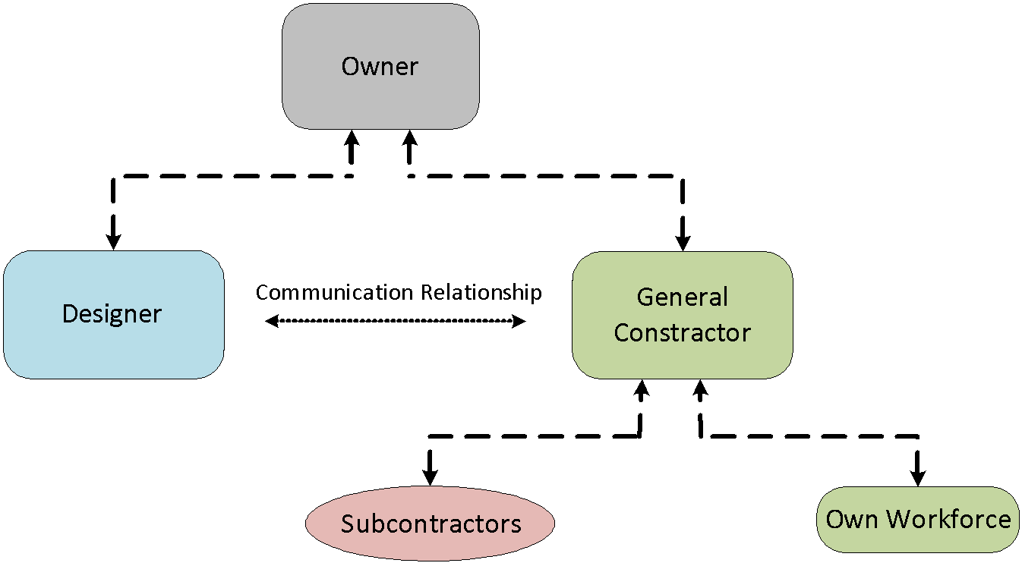
Project Delivery Systems - Traditional
Dr C.J. Willis, CAPM, P.Eng
‹#›

Slide 7
Project Delivery Systems : Traditional
The owner enters into two separate contracts
  One with a single designer
  Another with a single general contractor
The single general contractor usually uses his own workforce and enters into contracts with numerous subcontractors
In this system, the contract type used between the owner and the general contractors can be:
  Lump sum, Unit price, or cost plus fixed fee contract
The design contract is usually a negotiated professional fee contract
Dr C.J. Willis, CAPM, P.Eng
‹#›

Slide 8
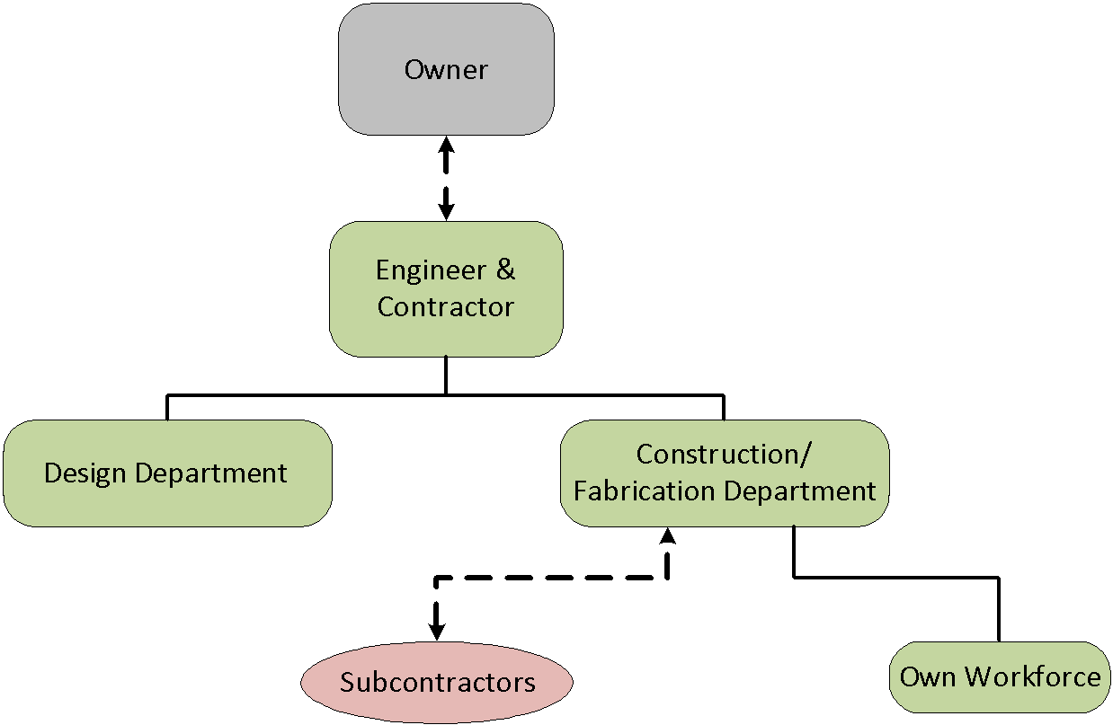
Project Delivery Systems :Turnkey (Design-Build)
Dr C.J. Willis, CAPM, P.Eng
‹#›
Notes:
Contracting method is different from contract type
There are many project delivery systems available to owners.
Owners tend to use the system that they are most familiar, rather than developing a solution to fit the project.
Contract type outlines how payment is going to be made
‹#›

Slide 9
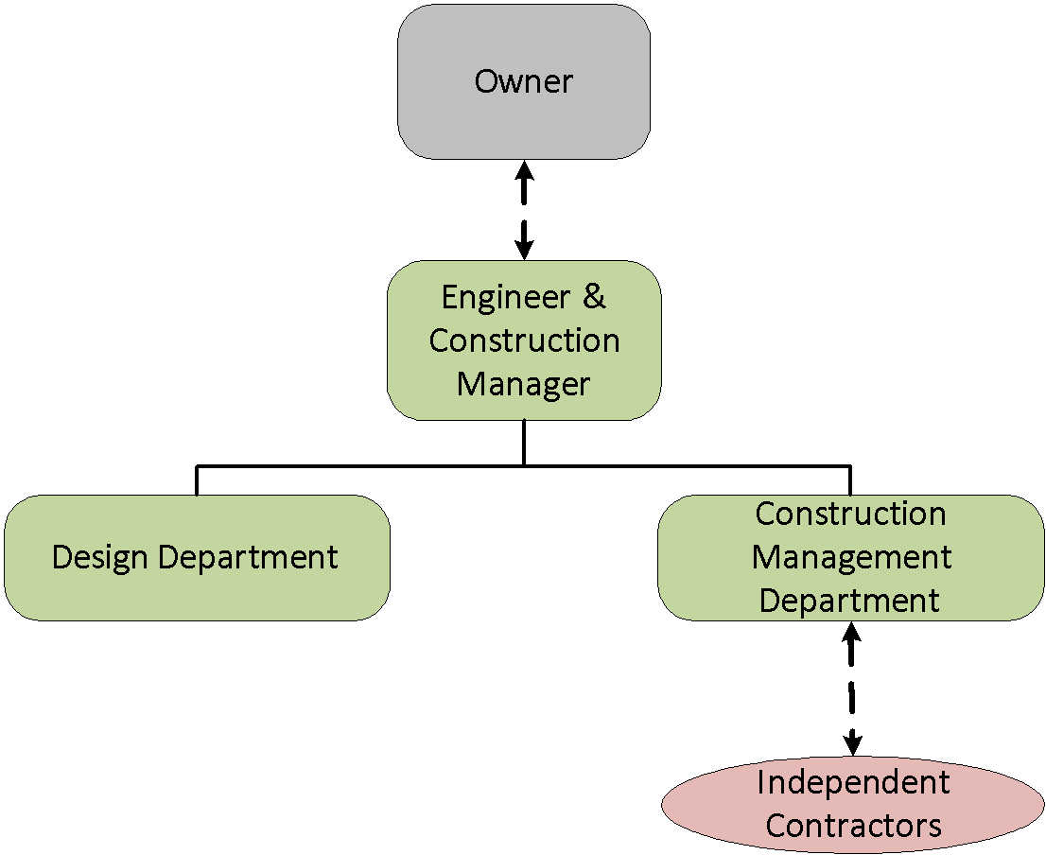
Project Delivery Systems : Turnkey (Design-Manage)
Dr C.J. Willis, CAPM, P.Eng
‹#›
Notes:
A project delivery system is used to allocate risk
An increase in project uncertainty usually leads to an increase in the project’s cost as well as an increase in disputes.
‹#›

Slide 10
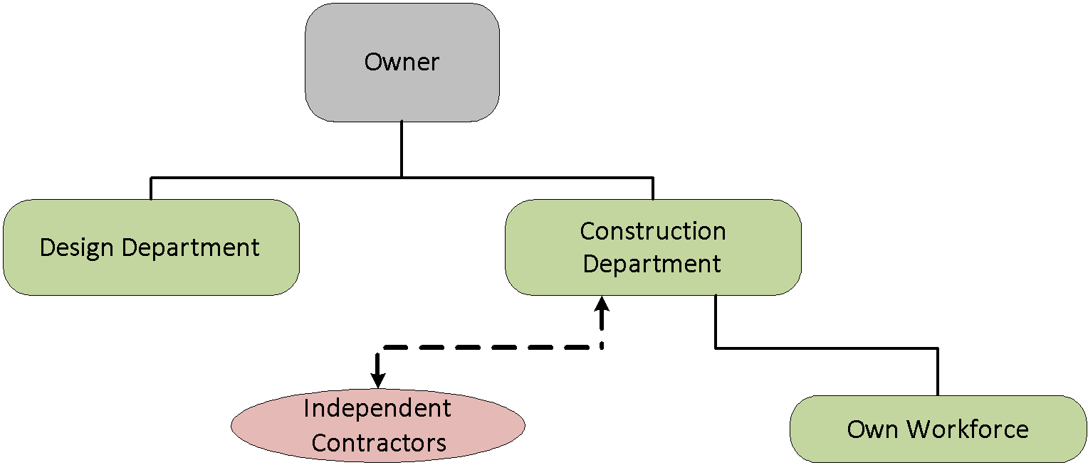
Project Delivery System: Owner-Builder
Dr C.J. Willis, CAPM, P.Eng
‹#›

Slide 11
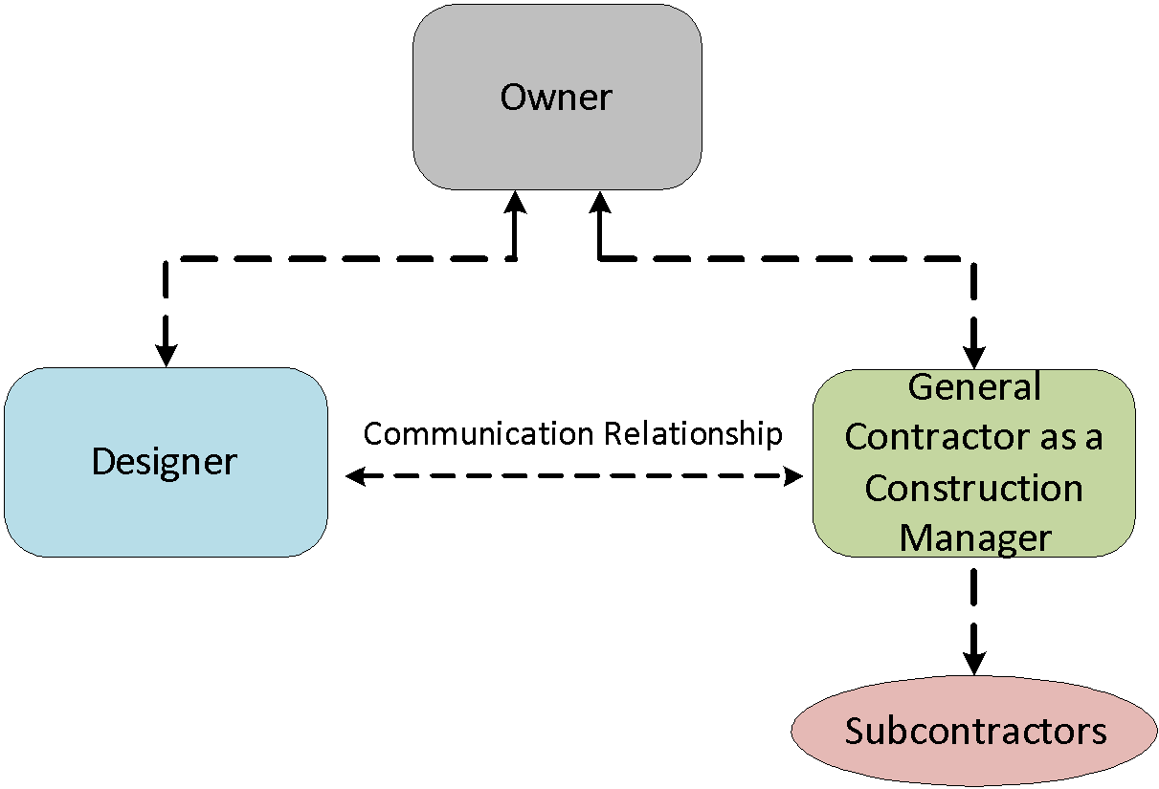
Professional Construction Management-General Contractor
Dr C.J. Willis, CAPM, P.Eng
‹#›

Slide 12
Professional Construction Management – General Contractor
Three party team of owner, separate designer and general contractor acting as Construction Manager
The general contractor enters into contracts with subcontractors (either lump sum or negotiated)
The general contractor may use some of his own forces but depends mainly on subcontractors
Negotiated design fees for design services
Dr C.J. Willis, CAPM, P.Eng
‹#›

Slide 13
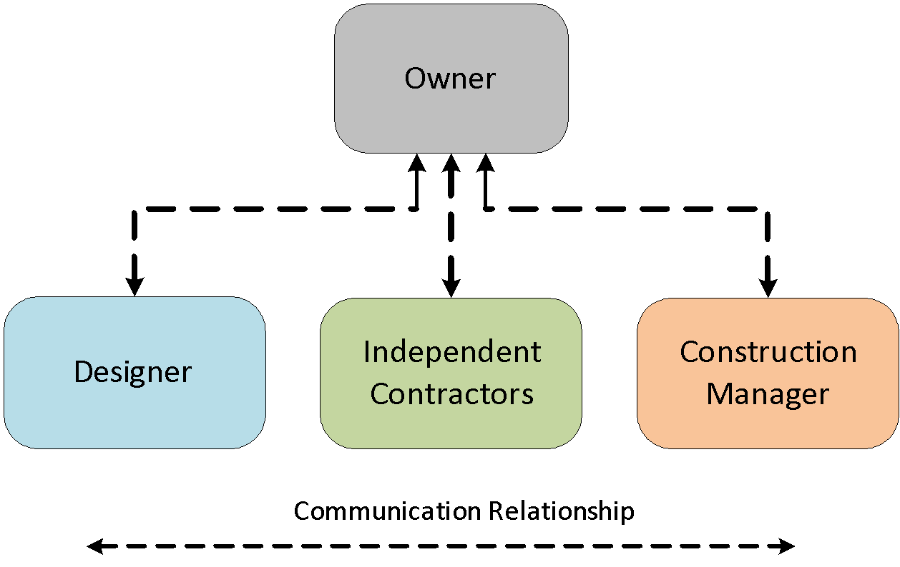
Professional Construction Manager – Construction Manager
Dr C.J. Willis, CAPM, P.Eng
‹#›
Notes:
Design-Bid-Build
The owner enters in contracts with two separate entities, i.e. designer and general contractor
Contract types can be lump sum, unit price and cost plus fixed fee
The single general contractor is responsible and liable for construction
‹#›

Slide 14
Planning
Why Plan?
  Planning is the basis of scheduling project activities
  Planning enables us to assign resources and responsibilities to activities
  Planning helps us to assign costs
Planning serves to define the project scope by its components
The primary function of a project plan is to serve the PM as a map of the route from project start to finish
Dr C.J. Willis, CAPM, P.Eng
‹#›

Slide 15
Work Breakdown Structure (WBS)
One output of planning is the work breakdown structure (WBS)
A work breakdown structure is a deliverable-oriented grouping of project elements that organizes and defines the total scope of the project.
Work not in the WBS is outside the scope of the project.
As with the scope statement, the WBS is often used to develop or confirm a common understanding of project scope
Dr C.J. Willis, CAPM, P.Eng
‹#›

Slide 16
Work Breakdown Structure
In the WBS, all project tasks are arranged hierarchically
  It is sometimes presented like a tree, much like an organization chart.
  The project deliverable is placed at the top and the level 1 tasks are placed below it.
  Below each of the level 1 tasks are the level 2 tasks and so on.
  Tasks are identified using an identifier number.
The WBS is a hierarchical breakdown of the scope of work
  It provides a common, ordered hierarchy framework for summarizing information and for quantitative reporting.
Dr C.J. Willis, CAPM, P.Eng
‹#›

Slide 17
Work Breakdown Structure (WBS)
Work not in the WBS is outside the scope of the project.
In the WBS, the project is broken down into work packages
A work package is a well defined scope of work that usually terminates in a deliverable product.
Work packages may vary in size, but must be a measurable and controllable unit of work to be performed.
Elements of WBS should be mutually exclusive and collectively exhaustive.
Dr C.J. Willis, CAPM, P.Eng
‹#›
Notes:
The owner enters into a single contract with a firm that does both the design and construction work (Engineer Contractor). The Engineer Contractor can enter into contracts with design and construction entities to get the work accomplished.
This system is best used when a specialty contractor is required, such as one specializing in the construction of a rice mill, sugar mill, pulp and paper mill.
The contract types suitable for this project delivery system include lump sum, cost plus a fee
Construction can be performed under a phased construction program to minimize project duration
‹#›

Slide 18
Work Breakdown Structure
A WBS model could consist of the following levels of detail:
Level 1 – Scope
  Level 2 – Facility (Building)
  Level 3 – (system) – Superstructure
  Level 4 – (subsystem) – Floor Construction
  Level 5 – (assembly category) – Floor Decks and Slab
  Level 6 – (assembly) – Precast Concrete Slab
  Level 7 – (detail line item) – Erection Precast Slab
Dr C.J. Willis, CAPM, P.Eng
‹#›

Slide 19
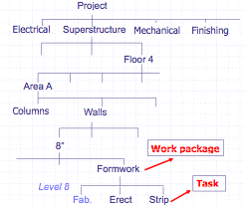
Example of a WBS
Dr C.J. Willis, CAPM, P.Eng
‹#›
Notes:
In this system, the owner enters into a contract with a single entity that designs and manages the construction of the facility.
All phases of the project are handled by this single organization.
Owner enters into a contract with a single entity for both design and construction
The entity enters into contracts with independent contractors
Contract types suitable to this system include:
Lump sum, cost plus a fee, design-construction contract
The entity manages many independent general contractors
Construction can be performed under a phased construction program to minimize project duration
‹#›

Slide 20
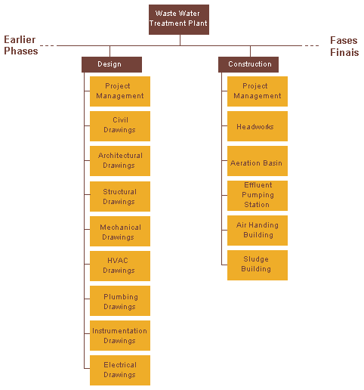
Sample WBS for a Waste Water Treatment Plant
Dr C.J. Willis, CAPM, P.Eng
‹#›

